Slide 1
Lesson Review 2: Review to Pointers
ITDSTRUC /CSDSTRUC
Data Structures and Algorithm

Slide 2
What is pointer?
    -special type of variable used to store an address.
    -declaration:
type *pointerName;
-same type as the variable whose address they are storing
ex: int *myPointer

Slide 3
Pointers (cont..)
Do not define multiple pointers in one line like this:
int *p1, p2, v1;
Should be: int *p1, *p2, v1;

Slide 4
Pointers (cont..)
  To assign a value to a pointer, use address-of operator (&).
int myInt = 904;
int *myPointer;
myPointer = &myInt;

Slide 5
Pointers (cont..)
When discussing pointer and pointer variables, we speak of pointing rather than speaking of addresses.
When a pointer variable (p1), contains the address of a variable (v1), then pointer p1 is said
“to point to variable v1” or a “pointer to variable v1 (*p1) “
    int v1 = 5;
    int *p1;
    p1 = &v1;

Slide 6
Dereferencing Operator
Using the ( * ) symbol to point to a variable rather than declaring a pointer.
  int *p, v;
  v = 0;
  p = &v;
  *p = 42;
  cout << v << endl;
  cout << *p << endl;

Slide 7
Pointer Operators
The * operator in front of a pointer variable produces the variable to which it points. When used this way, the * operator is called the dereferencing operator.
To assign a value to a pointer (the value being an address in memory), use the address-of operator (&).
      int myInt = 904;
      int *myPointer;
      myPointer = &myInt;

Slide 8
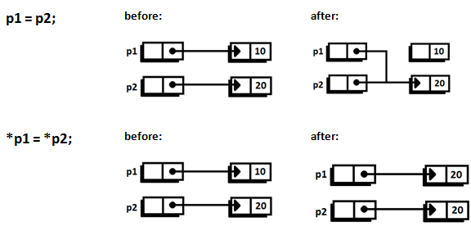
Pointers (example)

Slide 9
new
creates a new dynamic variable of a specified type and returns a pointer that points to this new variable.
example:
p1 = new int;
•This new, nameless variable can be referred to as *p1 (that is, as the variable pointed by p1)

Slide 10
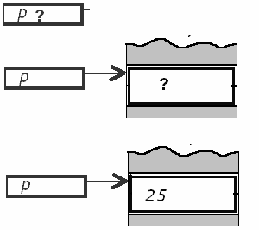
Dynamic Variables: ‘new’ operator
A dynamic variable is created and
destroyed while the program is running
int *p ;
p = new int ;
creates a new dynamic integer variable and
leaves p to point to this variable
*p = 25 ;

Slide 11
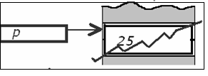
Dynamic Variables: ‘delete’ operator
delete p ; destroys the dynamic variable pointed by p
After delete p, p becomes an undefined pointer variable: a dangling pointer.
Take care: before using * again, be sure p points to something and is not a dangling pointer. Otherwise unpredictable effects.

Slide 12
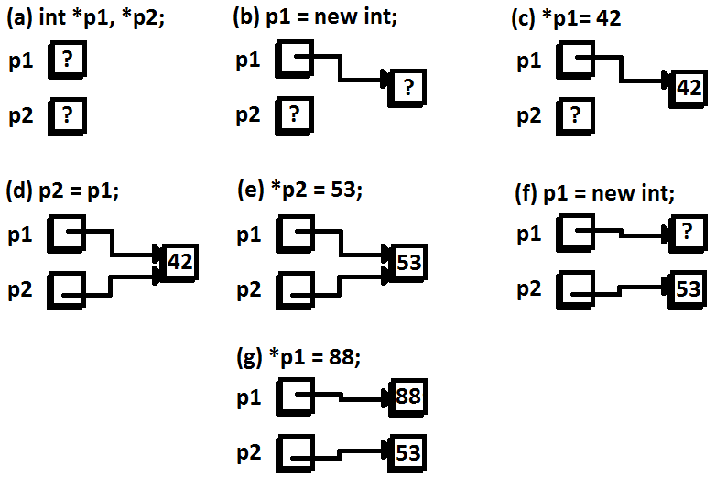
Illustration:

Slide 13
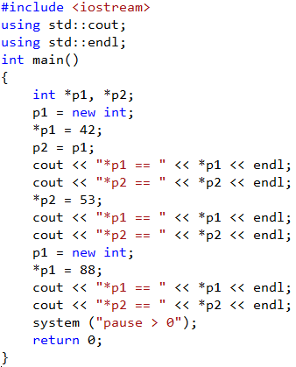
Example

Slide 14
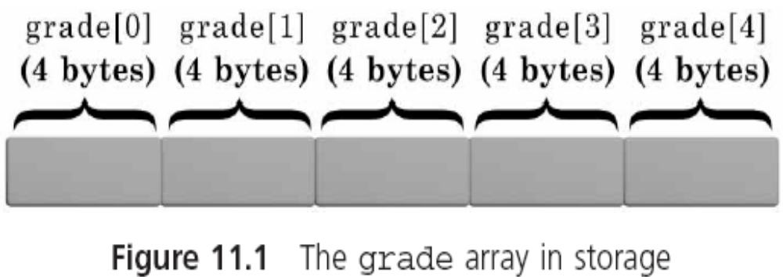
Array Names as Pointers
-pointer to its base address (1st element)
-each integer requires 4 bytes of storage

Slide 15
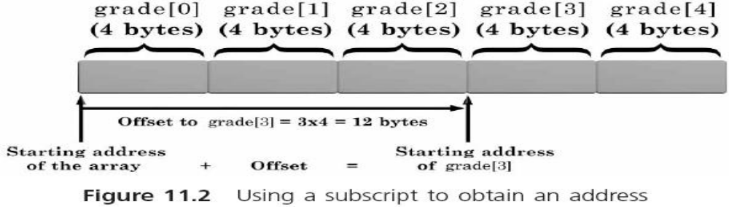
Array Names as Pointers
-subscript
–> calculate the array element’s address
&grade[3] = &grade[0] + (3*sizeof (int))

Slide 16
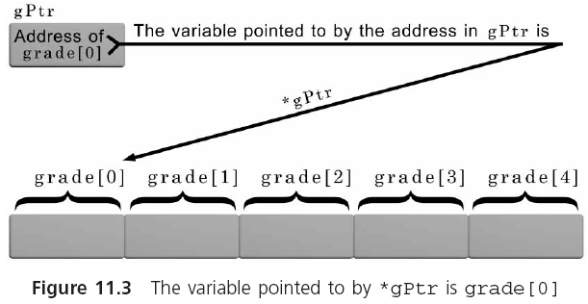
Array Names as Pointers
-storing of array element 0 in a pointer
-> you can use its address to access each element

Slide 17
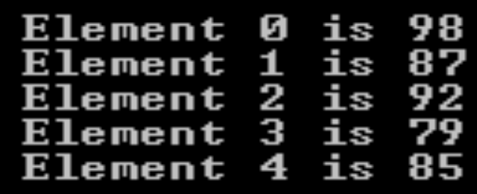
Array Names as Pointers
#include <iostream>
using namespace std;
#define NUMELS 5
int main()
{
int i;
int grade[] = {98, 87, 92, 79, 85};
for(i = 0; i < NUMELS; i++)
cout << "Element " << i << " is " << grade[i] << endl;
return

Slide 18
Array Names as Pointers
#include <iostream>
using namespace std;
#define NUMELS 5
int main()
{
int *gPtr, i;
int grade[] = {98, 87, 92, 79, 85};
gPtr = &grade[0];
for(i = 0; i < NUMELS; i++)
cout << "Element " << i << " is " << *(gPtr+i) <<endl;
return 0;
}

Slide 19
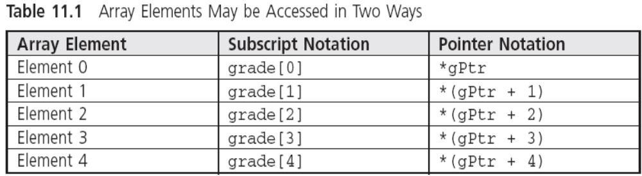
Array Names as Pointers

Slide 20
Advanced Pointer Notation
array elements can be accessed using pointer notation (by using same array name)
  int p[3];
  &p[0] is equivalent to p
  &p[1] is equivalent to p+1
  &p[2] is equivalen to p+2

Slide 21
Advanced Pointer Notation
#include <iostream>
using namespace std;
int main() {
float a[5];
cout<<"Displaying address using pointers notation: "<< endl;
for (int i = 0; i < 5; ++i) {
cout << a+i <<endl;
}
return 0;
}

Slide 22
Advanced Pointer Notation
#include <iostream>
using namespace std;
int main() {
float a[5];
// Inserting data using pointer notation
cout << "Enter 5 numbers: ";
for (int i = 0; i < 5; ++i) {
cin >> *(a+i) ;
}
// Displaying data using pointer notation
cout << "Displaying data: " << endl;
for (int i = 0; i < 5; ++i) {
cout << *(a+i) << endl ;
}
return 0;
}

Slide 23
Pointer Arithmetic
Four basic arithmetic operations:
++, -- , + and -
Addition and subtraction of pointer is a result of an “address”
Difference of two memory address is a result of an “integer”
Incremented -> next memory location
Decremented -> previous memory location

Slide 24
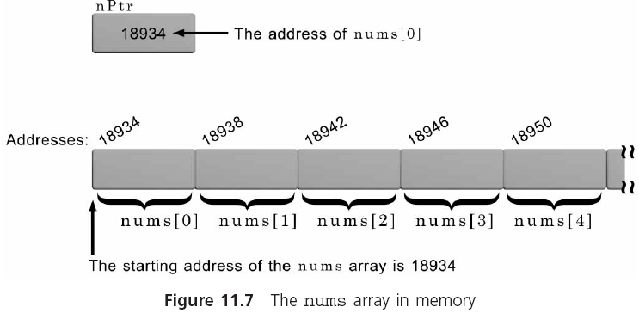
Pointer Arithmetic
int nums[100];
int *nPtr;
nPtr = &nums[0];
nPtr = nums;

Slide 25
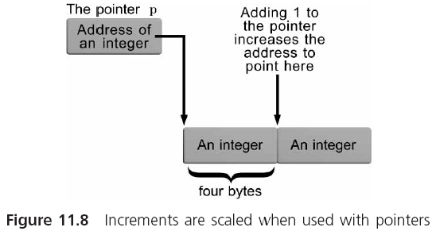
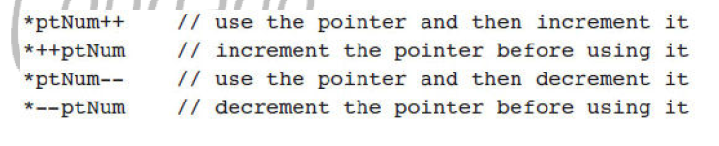
Pointer Arithmetic (continued)

Slide 26
Incrementing a Pointer
-use variable pointer rather than the array
  #include <iostream>
  using namespace std;
  const int MAX = 3;
  int main ()
  {
  int var[MAX] = {10, 100, 200};
  int *ptr;
  // let us have array address in pointer.
  ptr = var;
  for (int i = 0; i < MAX; i++)
  {
  cout << "Address of var[" << i << "] = ";
  cout << ptr << endl;
  cout << "Value of var[" << i << "] = ";
  cout << *ptr << endl;
  // point to the next location
  ptr++;
  }
  return 0;
  }
Address of var[0] = 0xbfa088b0
Value of var[0] = 10
Address of var[1] = 0xbfa088b4
Value of var[1] = 100
Address of var[2] = 0xbfa088b8
Value of var[2] = 200

Slide 27
Decrementing a Pointer
-use variable pointer rather than the array
  #include <iostream>
  using namespace std;
  const int MAX = 3;
  int main ()
  {
  int var[MAX] = {10, 100, 200};
  int *ptr;
  // let us have address of the last element in pointer.
  ptr = &var[MAX-1];
  for (int i = MAX; i > 0; i--)
  {
  cout << "Address of var[" << i << "] = ";
  cout << ptr << endl;
  cout << "Value of var[" << i << "] = ";
  cout << *ptr << endl;
  // point to the previous location
  ptr--;
  }
  return 0;
  }
Address of var[3] = 0xbfdb70f8
Value of var[3] = 200
Address of var[2] = 0xbfdb70f4
Value of var[2] = 100
Address of var[1] = 0xbfdb70f0
Value of var[1] = 10

Slide 28
Pointer arithmetic
-
#include <iostream>
using namespace std;
#define NUMELS 5
int main()
{
int nums[NUMELS] = {16, 54, 7, 43, -5};
int i, total = 0, *nPtr;
nPtr = nums; //store address of nums[0] in nPtr
for(i = 0; i < NUMELS; i++)
total += *nPtr++;
cout << "The total of the array elements is "<< total;
return
  }
//Can be replaced with total=total+*nPtr++

Slide 29
Pointer Initialization
Pointers can be initialized when they are declared:
  char *myname="John Doe";
  int x = 10;
  int *ptr = &x;

Slide 30
Pointers to Structures
A pointer can point to a structure, just as it can to any other variable, and to refer to the individual parts (members) of the structure (to access the stored value)
    #include <iostream>
    using namespace std;
    struct temp {
    int i;
    float f;
    };
    int main() {
    temp *ptr;
    return 0;
    }

Slide 31
Pointers to Structures
#include <iostream>
using namespace std;
struct Distance {
int feet;
float inch;
};
int main() {
Distance *ptr, d;
ptr = &d;
cout << "Enter feet: ";
cin >> (*ptr).feet;
cout << "Enter inch: ";
cin >> (*ptr).inch;
cout << "Displaying information." << endl;
cout << "Distance = " << (*ptr).feet << " feet " << (*ptr).inch << " inches";
return 0;
}

Slide 32
Pointers to Structures
The syntax to access member function using pointer is ugly and there is alternative notation
-> which is more common.
ptr->feet is same as (*ptr).feet
ptr->inch is same as (*ptr).inch

Slide 33
Passing Addresses to Functions
#include <iostream>
using namespace std;
void changeVar(int *myVar, int newValue);
int main()
{
int myNum = 20;
changeVar(&myNum, 90);
// rest of the main program
cin.get(); return 0;
}
void changeVar ( int *myVar, int newValue)
{
*myVar = newValue;
}

Slide 34
Program Swap Value
#include <iostream>
using namespace std;
void swap(int *first, int *second);
int main()
{
int myNum1 = 239;
int myNum2 = 932;
cout << “Initial value of myNum1 and myNum2:“;
cout << myNum1 << myNum2 << “\n\n”;
swap(&myNum1, &myNum2);
cout << “After function call, myNum1 and myNum2 << “has now a value of “
<< myNum1 << myNum2;
cin.get();
return 0;
}
void swap(int *first, int *second)
{
int temp;
temp = *first;
*first = *second;
*second = temp;
}

Slide 35
Summary
An array name is a pointer constant
Any access to an array element using subscript notation can always be replaced using pointer notation
Arrays are passed to functions by address, not by value
When a single-dimensional array is passed to a function, the parameter declaration for the array can be either an array declaration or a pointer declaration

Slide 36
Summary (continued)
In place of subscripts, pointer notation and pointer arithmetic are especially useful for manipulating string elements
String storage can be created by declaring an array of characters or a pointer to be a character
Pointers can be incremented, decremented, and compared

Slide 37
“Everyone has to be somewhere”

Slide 38
End of Module 4

Slide 39
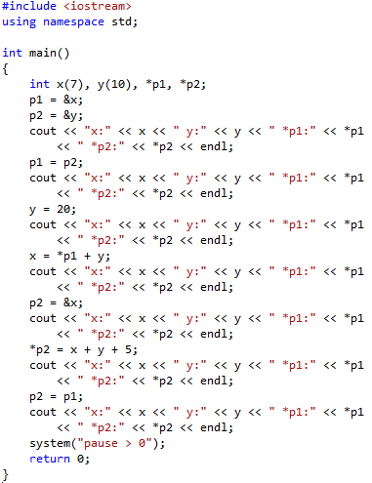
Short Quiz

Slide 40

Answer to short quiz

